Slide 1
Public Research Fellows
Humanities Student Focus Group Lunch
3/29/23 • 11:45-1:00pm • DB 202

Slide 3
What are we doing here?
You are here to converse and share your experiences as a humanities student. But why?
Our work this year has been geared toward building a humanities hub at UP
Foster community between disciplines
Provide more resources for students
Help facilitate the integration of humanities approaches in classrooms
Connect with the Portland Community
As STEM fields get more attention and funding every year, we want to reinforce the presence of the humanities on campus
In order to establish a hub that can best serve the UP community it is essential that we have the student perspective

Slide 4
Introductions
Name, major/minor, and what's one word you would use to describe your experience as a humanities major/minor at UP?

Slide 5
Question One
How did you choose your major/minor? What contributed to your choice?

Slide 6
Question Two
Have you felt supported in your choice of major or minor? How?

Slide 7
Question Three
Do you feel a sense of community and connectivity with other humanities students on the rest of campus?

Slide 8
Question Four
How do you feel the rest of campus perceives humanities students?

Slide 9
Question Five
What kinds of support do you see students in non-humanities fields getting that you would like to have?

Slide 10
Question Six
What sorts of professional development or internship opportunities have you taken advantage of here at UP? What resources in this area would be helpful?
Alumni network idea
Humanities major into a career course
Humanities internship program

Slide 11
Question Seven
Many fields have a direct path toward a career (Nursing, Engineering, etc.) but the humanities tend to be more open-ended and don’t have this as much. How do you see your major relating to your future career/school/personal development?

Slide 12
Question Eight
How do you conceive of humanities research? Have you done humanities research on campus? What did that look like?

Slide 13
Question Nine
What do you think of as defining aspects of the humanities?

Slide 14
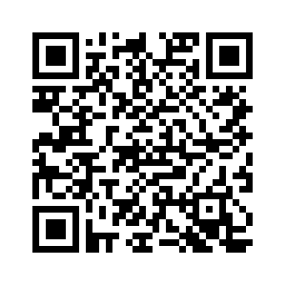
QR Code
Scan here to take our survey-->

